Slide 1
AGENT SCORECARD & PREMIUM PREDICTION
ML team – PIB

Slide 2
Innovation – Agent Metadata
Reporting Lines
Branches
Data – Agent View table; PIB
Data size – records: 1,586,809 & features: 49
LOBs – 14 unique
#Agents – 4,589 unique
Dealing with accounting year of Agent
Reporting line – 10 lines
Assumptions of Agent records
Non-Zero Net Earned Premium is considered
Positive Net Incurred Claim is considered
Non-Zero no of Policies is considered
PAMP Affinity
POS/Affinity
Alternative Channel
Inhouse & Strategic Alliance
Reinsurance
Accounting year
2022
2024
2023
2025
KL Agency
DBCC
Grouping on lob, reporting lines
Frequency, Severity & Loss Ratio
Final Score logic
Grouping: reporting lines
Analyze on reporting lines
NIC/NEP ratio
Classify Agents
Steps for Agent Analysis
Cost Center

Slide 3
Innovation – Agent Scoring Metric Logic
Profitability (weight = 40%)
Define LOB score by calculating difference between threshold and loss ratio for each LOB-agent record
Claims (weight = 30%)
Replace missing values with 0
Revenue Growth (weight = 30%)
Get previous year’s NEP value
Normalize the LOB score
Define claim score by sum frequency & severity
Normalize the Claim score
Compute growth as %age change
Normalize the Growth score
Percentile Threshold for High labelling
75%ile
70%ile
Zones & Quadrants
Final Score | NIC/NEP Ratio | Classification
High | Low | ✅ Efficient Performer
Low | Low | ⚠️ Low Performer
High | High | 🚩 High-Loss Performer
Low | High | ❌ High-Risk Underperformer
Key Features
Agent Class
Final Score
Data Grouping

Slide 4
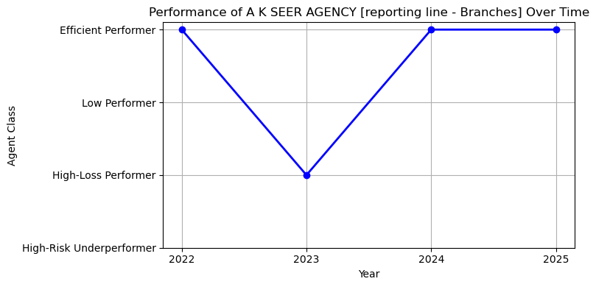
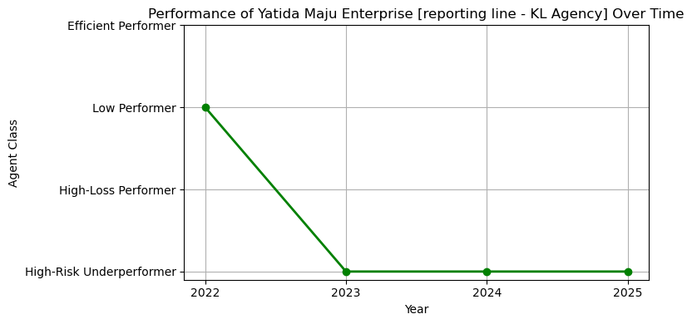
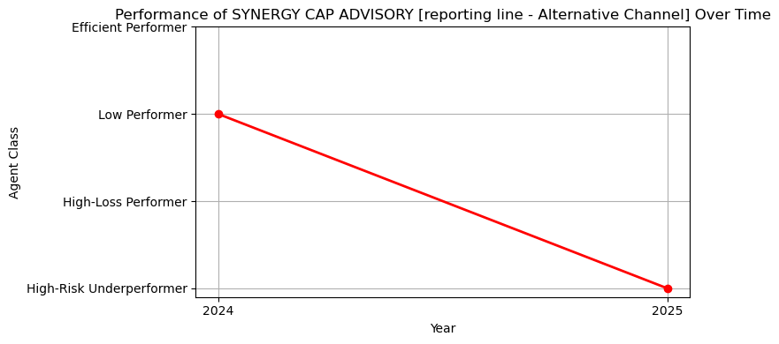
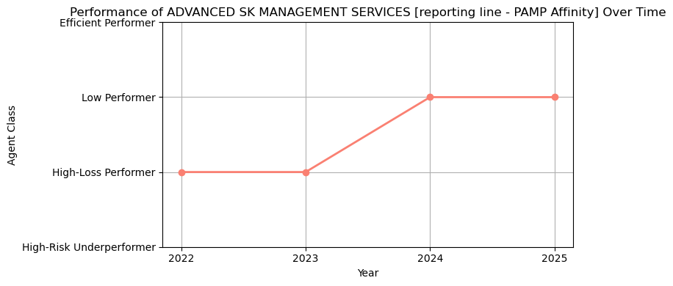
Innovation – Few Agent Trends
Results
Yatida Maju Enterprize
A K SEER Agency
Synergy Cap Advisory
Advanced SK Management Services

Slide 5
Innovation – Enhance Risk Assessment with Predictive Modelling
Modelling Process
Preprocessing / Cleaning
Exploration Analysis
Handling Imbalance
Feature Engineering
Model Development
Parameter Tuning & Optimization
Training, Testing & Generalization
Data Gathering
Model Selection based on Accuracy & Feature Importance
Training Data
1559434 Policies
Test Data
166065 Policies
XGBoost
Customer age
CATBoost
no. of claims
Logistic Regression
no. of claims
Post code
Vehicle age
Make
No. of claims
NCB Percentage
Period
Cubic Capacity
Act / Non-Act
Act / Non-Act
NCB Percentage
Customer age
Preferred segment
Make
Vehicle age
Cubic Capacity
Customer gender
Act / Non-Act
Cubic Capacity
NCB Percentage
Vehicle age
Post code
Preferred segment
Customer Gender
Make
Supervised Classification
XGBoost Model Matrix
Precision 94%
Recall 97%
F1 Score 95%
Results
Data Selection
Segment : Private Car Comprehensive
Period : 2020-2024
Policies : 2,075,235
Features : 117

Slide 6
Innovation – Pricing Assessment with Predictive Modelling
Data Selection
Segment : Private Car Comprehensive
Period : 2020-2024
Policies : 2,075,235
Features : 117
Results
Iterations : 900
Train Fit : 84.90%
Test Fit (2023) : 84.12%
Test Fir (2024) : 81.20%
Training Data
2020-2022
Test Data
2023 & 2024
Model Selection & Feature Importance
Model: CATBoost Regressor

Slide 7
Thank You
ML team – PIB

